Slide 1






Sevak
IoT based underground drainage worker safety system

Slide 2

Abstract
The basic definition of IoT is as follows:-The Internet of things (IoT) is a system of interrelated computing devices, mechanical and digital machines provided with unique identifiers (UIDs) and the ability to transfer data over a network without requiring human-to-human or human-to-computer interaction.
Hence we can remotely monitor devices from anywhere.
The goal of this project is to create a smart IoT wearable that will monitor the health of the underground drainage workers as well as the environment in which they work.

Slide 3

Introduction
This process of designing a solution covers:
Problem statement
Detailed design
Chosen hardware and software

Slide 4
Problem Statement
The sewage system is an important component of the urban infrastructure.It is considered to be a city’s lifeline where millions of people live.The process of maintaining the drainage system is an arduous task and puts the people working in it at risk.Manual monitoring and cleaning of drainage is necessary but it leads to accidental death of workers when they inhale poisonous gases during working.The gases present in these waste lines such as methane and carbon monoxide is harmful and can cause serious fatalities to the life of a drainage worker.Most of the drainage workers will not know the amount of gas present in the waste lines,which is one of the main causes for the many number of accidental deaths and infections.

Slide 5
Detailed Design
The development will involve a smart head gear and smart watch that will monitor the health of the worker as well as the working environment.

Slide 6
Features of head gear
Harmful gas detection with heat sink.
Obstacle detection.
Alerts when the harmful gas levels goes beyond the threshold level.
Temperature detection.
Location of worker using GPS.
Features of watch
Heart rate sensing.
Alerts when the pulse of the worker falls below normal BPM.
Emergency button in case he gets trapped.
Fall detection

Slide 7
Design Map
Creation of an IoT based sanitation worker safety system.
Head Gear
Watch
Temperature sensor(DHT22)
Pulse sensor(Sen 11574)
Real time data and alerts if needed managed by ubidots
Real time data and alerts if needed managed by ubidots
Gas Sensors(Mq2,Mq9)
Fall sensor(MPU6050)
GPS(Neo 6M)
Emergency button
Ultrasonic sensor

Slide 8

Design Description
Our products that include a head gear and watch monitor a variety of parameters that include temperature of the surroundings, obstacles, location, level of harmful gases(CH4 and CO) and pulse of the person using various sensors. In addition, it also has a fall detection sensor and an emergency button.
These parameters are monitored real time. Ubidots is used for the analysis of real time data . It also creates alerts if the level of harmful gases cross a threshold value or if the pulse of the worker falls below normal BPM.
An emergency button that can be used by the workers to alert others in case he gets trapped.

Slide 9
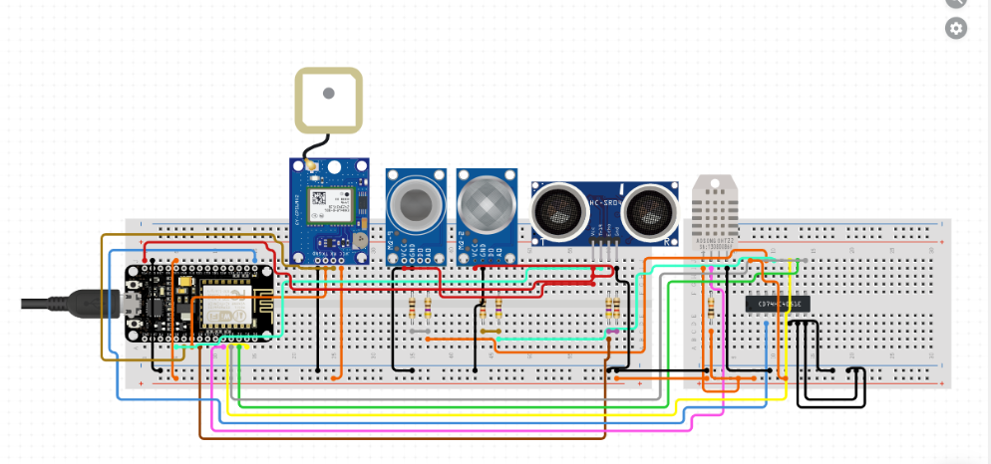
Circuit Diagram-Head Gear

Slide 10
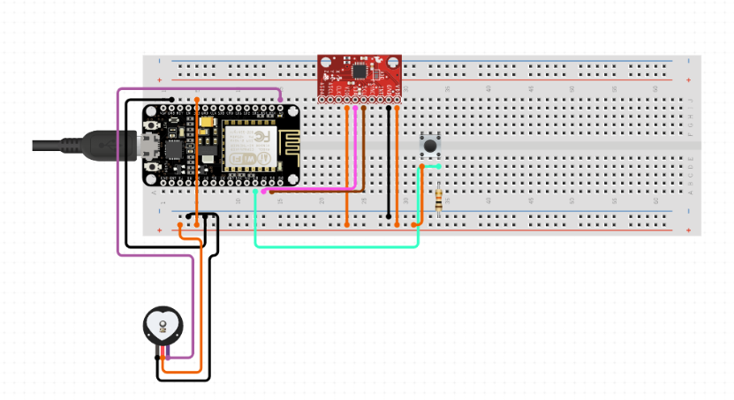
Circuit Diagram-Watch

Slide 11
Hardware and Software Used
Nodemcu
DHT22
Ultrasonic sensor HC-SR04
Neo 6-M
Mq9 gas sensor-Monitors level of carbon monoxide.
Mq2 gas sensor-Monitors level of methane.
Mpu6050
Sen 111574
Push button
Arduino IDE
Ubidots
ThingsSpeak

Slide 12


Conclusion
Our product “Sevak” thus is a cost effective IoT device that ensures the safety of those brave workers who clean the underground drainages.
Link to google drive: https://drive.google.com/folderview?id=1_Yuucp1-ZxGWWOjthEKUUfUzPc9R9uSc

